Slide 1

SMART INDIA HACKATHON 2026
Real-Time Airfare Price Index (APIx)
Problem Statement ID – SIH26056
Problem Statement Title- Real-Time Airfare Price Index (APIx) for India via Automated Web Scraping, for Augmentation of the CPI
Theme- Travel & Tourism
PS Category- Software
Team ID- SIH-UPES-2026-T061
Team Name:AXIOMS

Slide 2
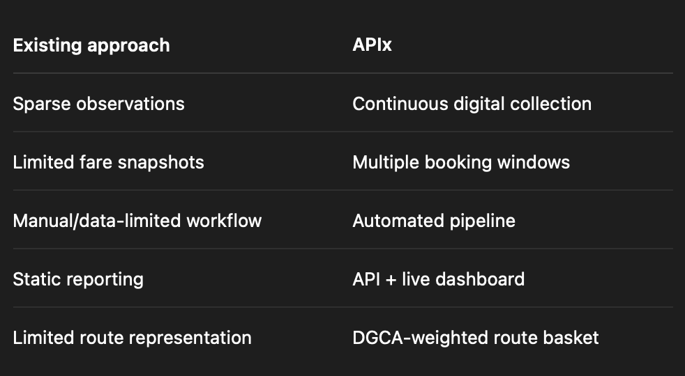

Real-Time Airfare Price Index (APIx)
AXIOMS
Proposed Solution
Automated pipeline: scrape airline & OTA fares → clean → compute CPI-style weighted Airfare Price Index — live via API & dashboard.
Replaces sparse manual CPI sampling with continuous capture of real 200–400% daily fare swings.
DGCA-weighted route basket + 5-window booking elasticity — working multi-source prototype, not just a concept.
@SIH Idea submission- Template

Slide 3
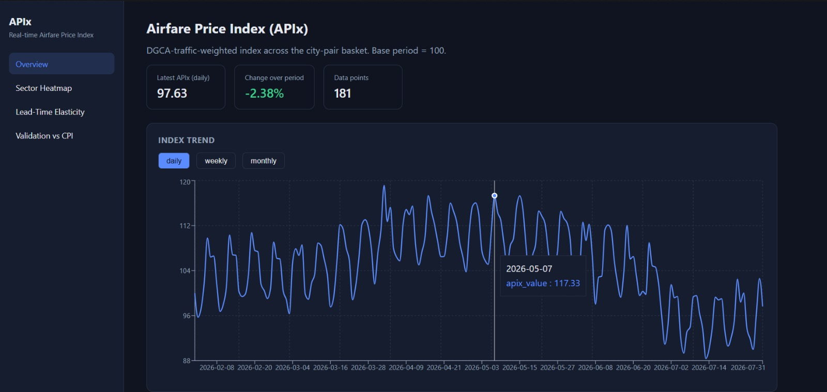
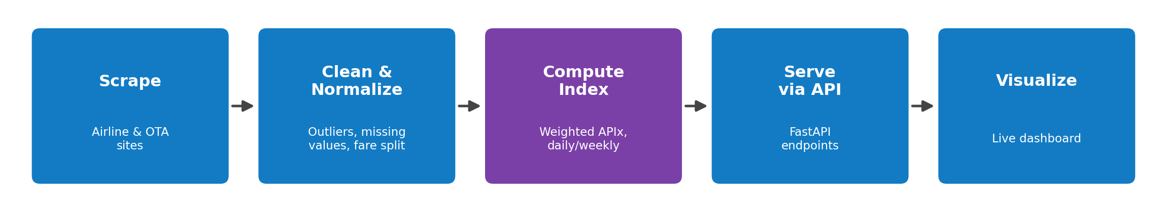
TECHNICAL APPROACH
AXIOMS
Python (Scrapy + Playwright) scraping · FastAPI backend · PostgreSQL/SQLite · React + Vite + Recharts dashboard · APScheduler automation.
Pipeline: Scrape → Clean & Normalize → Compute Weighted Index → Serve via API → Visualize on Dashboard — already working end-to-end.
Automated pytest suite for cleaning & index logic; documented, reproducible pipeline from raw data to dashboard.
@SIH Idea submission- Template

Slide 4
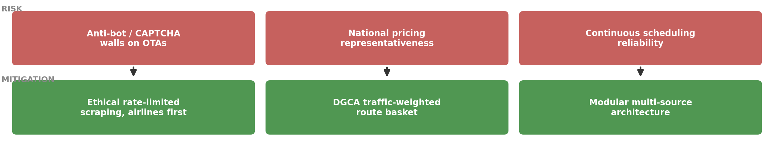
FEASIBILITY AND VIABILITY
AXIOMS
Technically feasible: public data, mature scraping tools, CPI-style index math — proven via 6-month(181Days)working-prototype backtest.
Key risks: anti-bot/CAPTCHA on OTAs · national-pricing representativeness · continuous scheduling reliability.
Strategies: ethical rate-limited scraping (airlines first) · modular multi-source architecture · continuous DGCA/CPI backtesting
@SIH Idea submission- Template

Slide 5
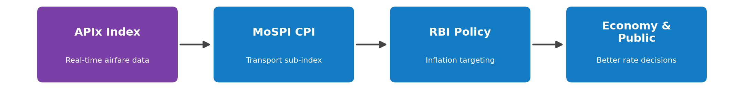
IMPACT AND BENEFITS
AXIOMS
High-frequency airfare data → improved airfare measurement → stronger CPI analysis → better evidence for economic decision-making
Economic: sharper inflation measurement · Governance: automates manual.
NSO process · Social: transparent pricing + bonus Future Extension insight.
@SIH Idea submission- Template

Slide 6
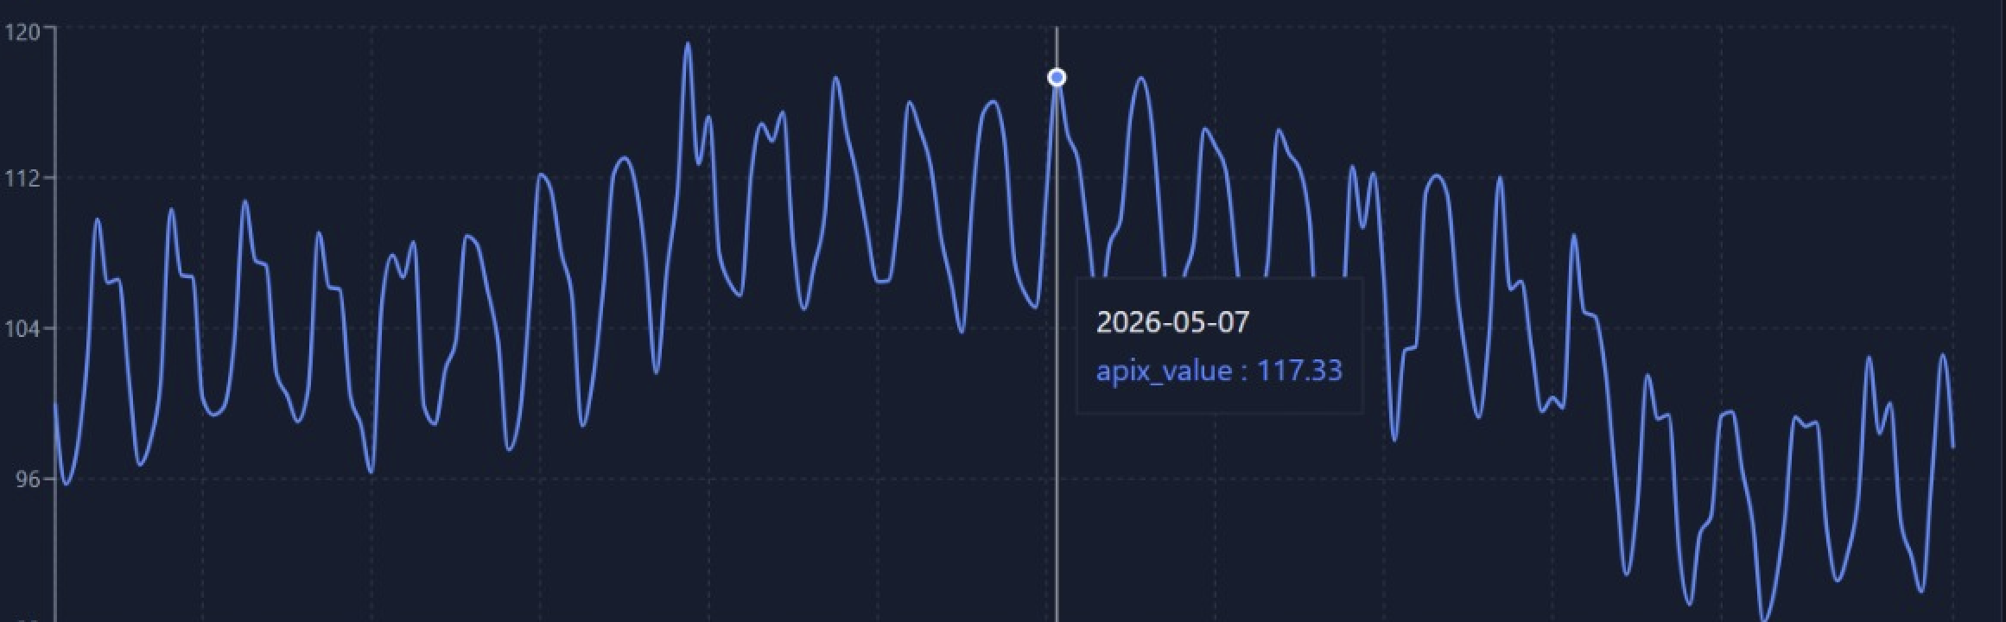
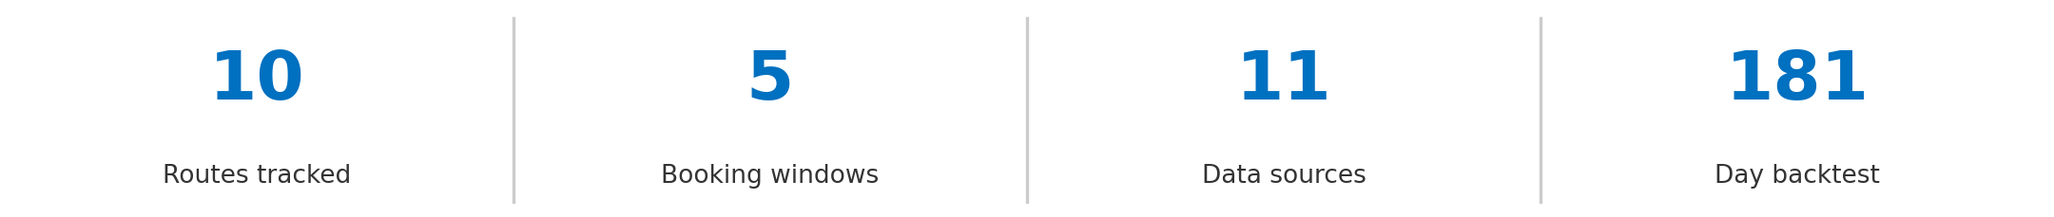
RESEARCH AND REFERENCES
AXIOMS
Government & Data Sources: MoSPI CPI Manual, 2024-base series mospi.gov.in DGCA monthly domestic passenger traffic statistics dgca.gov.in .
Methodology References: Laspeyres price-index construction (standard CPI methodology); RBI’s flexible inflation-targeting framework rbi.org.in
Prototype Validation: 6-month (181-day) backtest of our computed index against MoSPI’s CPI airfare series across 10 routes.
@SIH Idea submission- Template

